Slide 1
Comparing chunking strategies for RAG based QA systems
Shashank Sahoo
21st August 2023
KPMG UK
KPMG Framework Slides v1
February 2022

Slide 2
1. Text Chunking in Retrieval Augmented Generation (RAG) 2. Why it is essential ? 3. Key design considerations ? 4. Chunking methods 5. Estimate best chunk size for use-case 6. Sample calculation 7. Experiment Setup 8. Lets Collaborate for DS Corner
What we will cover:

Slide 3
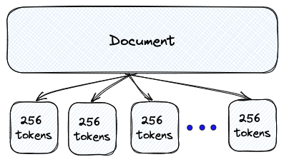
Text chunking in RAG : Introduction
In LLM context, Text chunking refers to the process of splitting down large pieces of structured or unstructured document text(s) into smaller segments. These segments are expected to be meaningful and manageable enough to support an explicit request of retrieval made by LLM for any downstream application like machine translation, text-summarization, question-answering etc.
LLM comprehends and responds quite differently based on whether the text chunks and thereby the embedding content is short (like sentences or phrases) or long-types (like paragraphs or pages).
Embedding vectors for short-type texts may miss out on broader contextual information found in a paragraph or document. (too short problem)
Embedding vectors for long-type texts takes into account the overall theme and the sentence relationships. This results on broader understanding, but might cause some noise or diminish the importance of individual sentences. (too long problem)
The query length also plays a significant role in establishing relationship
between embedding vectors,
Short query
Sentence Embedding
Long query
Paragraph Embedding

Slide 4
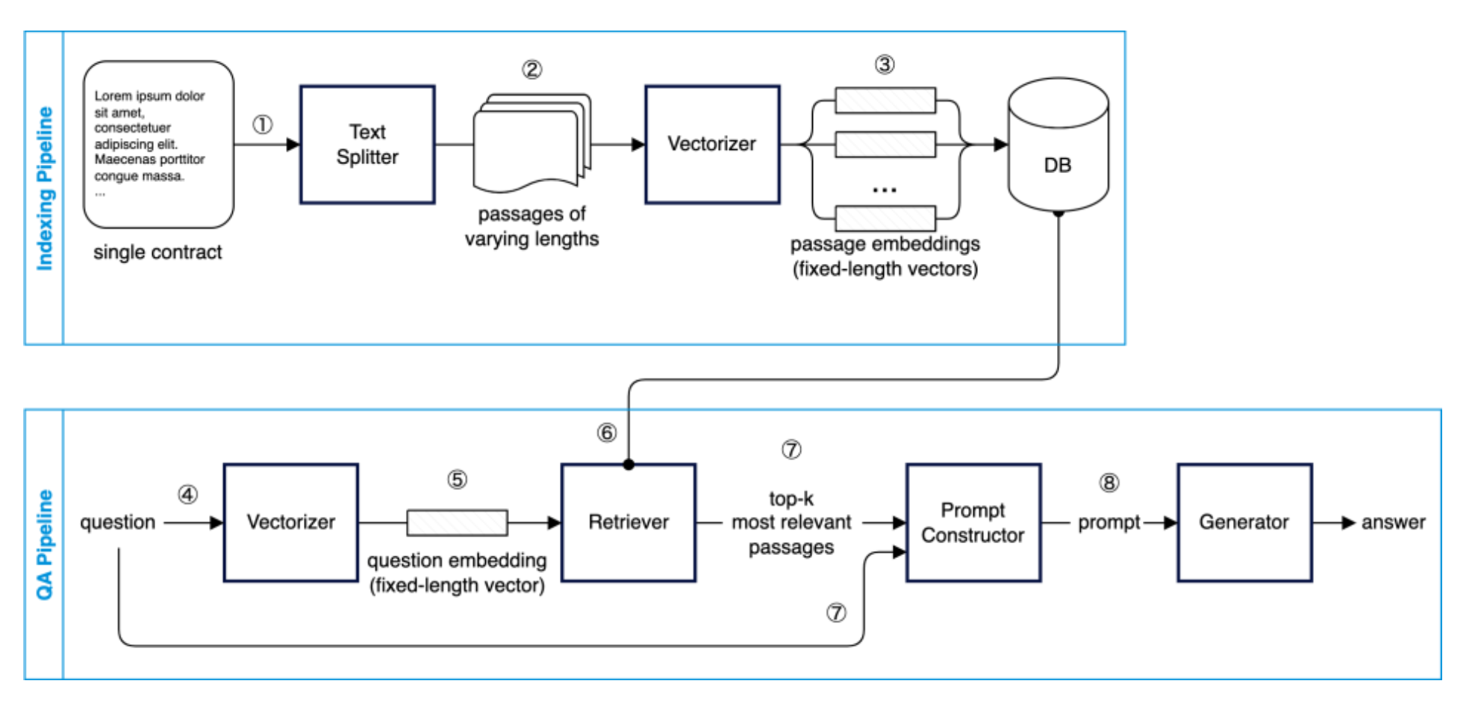
Text chunking in RAG : Reference Architecture
Large pre-trained language models have been shown to store factual knowledge in their parameters, and achieve state-of-the-art results when fine-tuned on downstream NLP tasks. However, their ability to access and precisely manipulate knowledge is still limited, and hence on knowledge-intensive tasks, their performance lags behind task-specific architectures. Additionally, providing provenance for their decisions and updating their world knowledge remain open research problems. Pretrained models with a differentiable access mechanism to explicit non-parametric memory have so far been only investigated for extractive downstream tasks. We explore a general-purpose fine-tuning recipe for retrieval-augmented generation (RAG) — models which combine pre-trained parametric and non-parametric memory for language generation. We introduce RAG models where the parametric memory is a pre-trained seq2seq model and the non-parametric memory is a dense vector index of Wikipedia, accessed with a pre-trained neural retriever. We compare two RAG formulations, one which conditions on the same retrieved passages across the whole generated sequence, and another which can use different passages per token. We fine-tune and evaluate our models on a wide range of knowledgeintensive NLP tasks and set the state of the art on three open domain QA tasks, outperforming parametric seq2seq models and task-specific retrieve-and-extract architectures.
Source : GO - Global Lighthouse Program - Regional LH Hubs - May 2023_Data_Science_Corner.pdf - All Documents (kpmg.com)

Slide 5
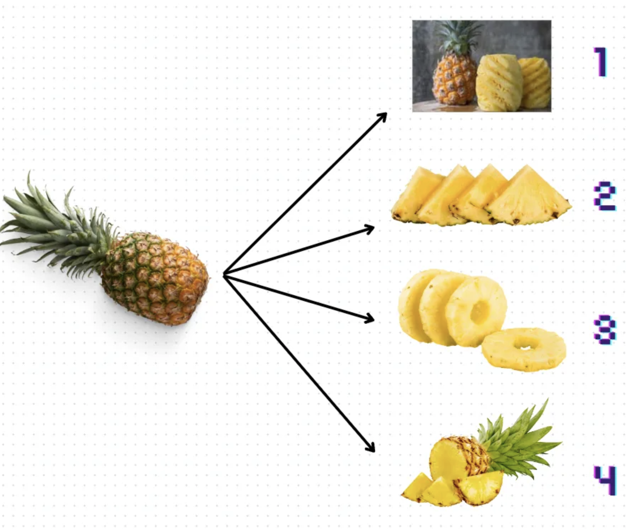
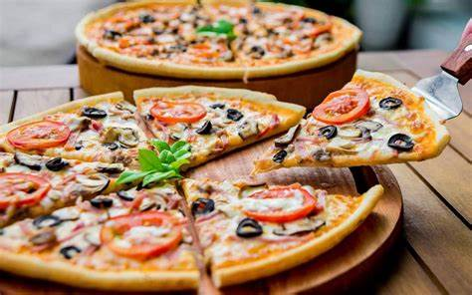
Text Chunking: Why it is essential ?
In semantic or vector search, we need to index a corpus of documents, with each document containing valuable information on a
specific topic. By applying an effective chunking strategy, we can ensure our search results accurately capture the essence
and coherence of the user’s query. Text chunking is essentially done in LLM based applications for the following compelling reasons:
For semantic relevance :
Chunking helps to make sure the content being looking and searched for is meaningful,
relevant and accurate when searching a vector database like Pinecone, Chroma etc.,
Avoid context token limits in LLM :
In LLM applications, chunking helps to keep context tokens from retrieval within the rules
or token limit set by language models, such as GPT-4.
Overcome too short or too large nuances :
If our chunks are too small or too large, it may lead to imprecise search results or missed
opportunities to surface relevant content. Finding the optimal chunk size for the documents in
the corpus is crucial. If a chunk has enough to make sense and meaning by itself without any
supporting text then it is probably good enough.
Best for Retrieval augmentation (RA) :
Before asking LLM with any request, one need to feed context(s) via RA
method whose performance is heavily influenced by text chunking methods.

Slide 6
Text Chunking: Key Considerations
In designing enterprise centric LLM application with RAG, we need to decide the most optimal chunking method based on various factors
and it differs from one application to other. Major considerations are :
Knowledge Document Characteristics:
Depending on the length, complexity and diversity of knowledge documents from sources, we can choose an embedding model and the
operating method to chunk.
Text Embedding Model:
Which embedding model to use and what chunk size does it perform optimally on? Some model works best on small chunks or sentences while others
perform better on large chunks or paragraphs.
Expected User Query Characteristics:
Will the expected user queries be short and specific or long and complex? This informs the way one needs to chunk contents
Purpose of Retrieval Augmentation based Search:
How the retrieved results be utilized in downstream application like question-answering, machine-translation, summarization etc. As a rule of thumb,
if the chunk of text makes sense without the surrounding context to a human, it will make sense to the language model as well.

Slide 7
Methods of Text Chunking
There are various types of Text splitters available from which we can choose based on the business use-case and nature of document data. Each of them might be appropriate for different situations and has it own benefits and limitations.
Fixed Size Chunking
Split by Characters
A naïve based preliminary approach. Simply choose “chunk_size” and “chunk_overlap” to configure - Computationally cheap - Doesn’t need any external NLP libraries
For Example : CharacterTextSplitter {“\n\n”}
Chunk size metric : # of characters
Chunk by method : single character
2. Split by Tokens
Byte-Pair Encoding (BPE) Tokenizers like tiktoken can be used to estimate total tokens in context as chunk size. Using same tokenizer as used in the language model is always recommended.
For Example : CharacterTextSplitter
Chunk size metric : # of tokens
Chunk by method : tiktoken tokenizers, HF tokenizers
“Content-Aware” Chunking
1. Sentence splitting
Based on sentence-level splitting using external libraries like NLTK, Spacy, Stanza etc.
2. Recursive chunking (most-common)
Cuts the text into smaller and smaller pieces in a structured and recursive way, making sure the chunks are smaller while preserving the context and semantic coherence.
For Example : RecursiveCharacterTextSplitter {"\n\n", "\n", " ", "”}
3. Semantic chunking with clustering
Sentence clustering is a technique to group sentences based on semantic similarity using sentence embeddings and K-Means/ Adjacent Sentence Clustering(ASC).
4. Specialized chunking
Contents. like Python, JS, Markdown, Latex, HTML etc can be used with special chunking methods during configuring

Slide 8
Estimate best chunk size for use-case
There is no fixed or well-defined criteria to strictly follow to estimate the best chunk-size in the context of use-case. As one-size-may-not-fit-all
, but in general the following recommendation can be adopted.
1. Data Pre-processing :
Ensuring data quality by removing unwanted tags, labels, markers etc., helps to minimize data noise levels and should be incorporated before
attempting for text chunking.
2. Range of chunk size and overlap :
Considering the content type, retrieval model and generation model, a range of chunk size values can be chosen. Using chunk overlap to ensure
not to miss an important connection or relevance between two adjacent or adjoining chunks.
3. Evaluate each chunk size and method :
It is recommended to try different chunk sizes and methods to see which one works best for the content and query combination. To test different chunk sizes,
we could use multiple data sets and iterate until the most optimal fit size is achieved.
4. Know your limits :
Calculate the actual token limit reserved for context while considering the shared max_token length of LLM between prompt and completion.

Slide 9
Text Chunking: Sample calculation
For example,
Model Type :With GPT-3.5-Turbo model, requests can use up to 4096 tokens shared between prompts and completions.
Task Type : “machine translation”
Input token space (prompts) –
instructions, system-message, user-message, query [approx. 200]
context [4097 – (2048+200) = approx. 1850]
Output token space (completions) - generated text. [approx. 2048]
{~40% : “summarization”, ~50% : “machine translation”, ~20% : QA}
So for context alone we only have 1850 actually reserved tokens.
For chunk_size = 100 & chunk_overlap = 10, we could have 1850/100 = approx. 18 text chunks
For chunk_size = 200 & chunk_overlap = 20, we could have 1850/200 = approx. 9 text chunks
For chunk_size = 300 & chunk_overlap = 30, we could have 1850/300 = approx. 6 text chunks

Slide 10
Text Chunking: Experiment Setup
Chunking methods to compare.
NLTK Sentence Tokenizer
Spacy Sentence Splitter
Langchain Text Splitter
KMeans Clustering
Adjacent Sentences/Sequence Clustering
Datasets : ContractNLI ? Any other dataset ?
Target task : Summarization or Machine Translation or Closed domain QA ?
Analytics : Distribution plots of chunk lengths in each method
Chunking strategy | Vectorizer(remove it/fixed) | Retriever(remove it/fixed) | Generator (remove it/fixed) | Exact Match(EM) or F1 score (Generator) | Recall@k (Retriever)
Each one of the above | sentence-transformers/all-MiniLM-L12-v2 |  | GPT-4
One approach | OpenAi Text Ada | Cosine similarity | GPT-4

Slide 11
Q&A

Slide 12
Feedbacks & Recommendation
Lets Collaborate !!
Consider some rare methodology like llamaIndex and add them to method list.
Add reference to model length
Choose one sentence splitter (NLTK, Spacy, etc.)
Take QA case for evaluation
QA response / perf vs a given chunking methods (specific eval)
We can consider human eval with approx. 50 Q, 100+ doc, eval by DI Team members
Chuncking Strategies (Choose 3 out of 5) | Performance Metric (Human Eval)
Sentence Splitter
Langchain Text Splitter (Recursive CharacterTextSplitter)
Adjacent Sentences/Sequence Clustering

Slide 13
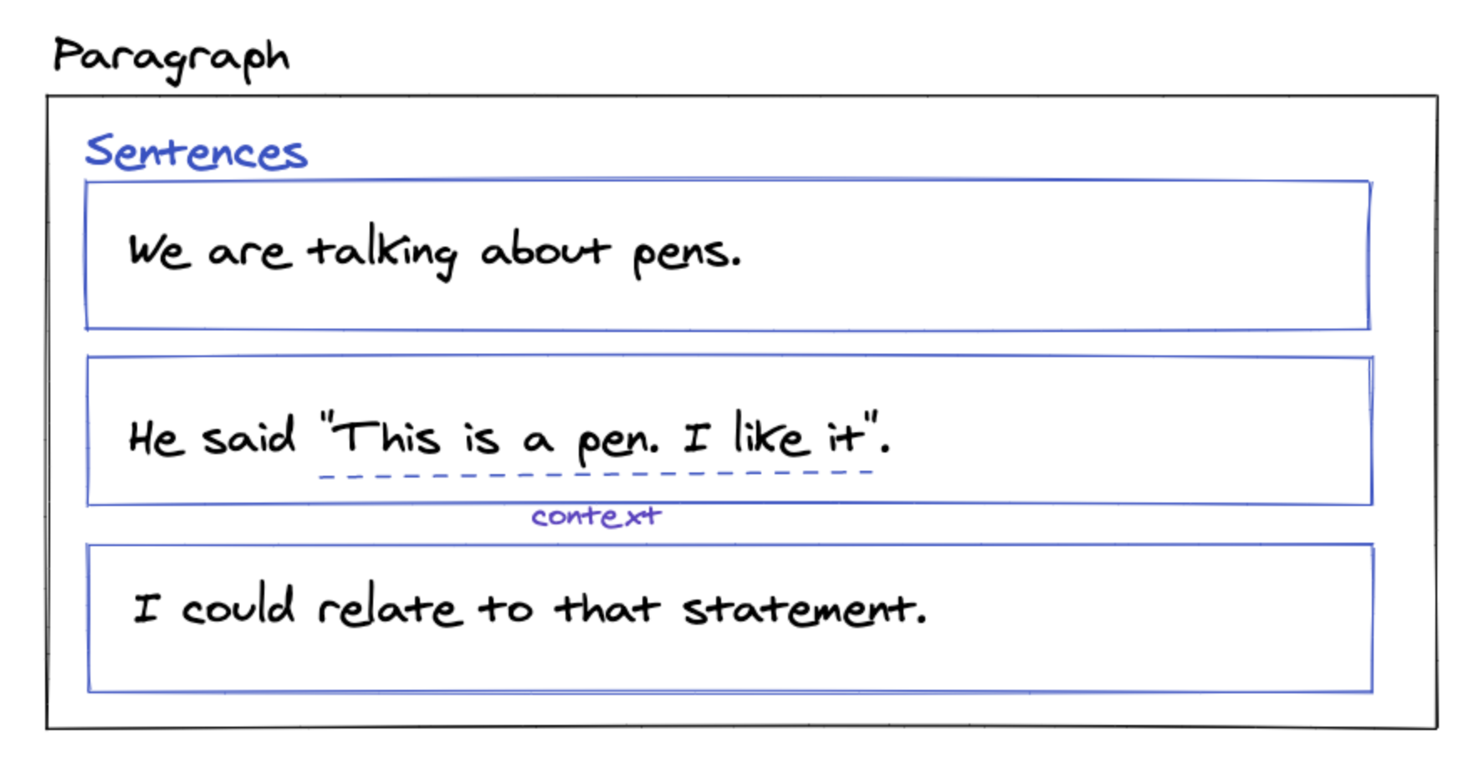
When a full paragraph or document is embedded, the embedding process considers both the overall context and the relationships between the sentences and phrases within the text. This can result in a more comprehensive vector representation that captures the broader meaning and themes of the text.
Chunking often aims to keep text with common context together.
With this in mind, we might want to specifically honor the structure of the document itself.
For example, a markdown file is organized by headers.
Creating chunks within specific header groups is an intuitive idea.
To address this challenge, we can use MarkdownHeaderTextSplitter.
This will split a markdown file by a specified set of headers.
Fixed-size chunking
This is the most common and straightforward approach to chunking: we simply decide the number of tokens in our chunk and, optionally, whether there should be any overlap between them. In general, we will want to keep some overlap between chunks to make sure that the semantic context doesn’t get lost between chunks. Fixed-sized chunking will be the best path in most common cases. Compared to other forms of chunking, fixed-sized chunking is computationally cheap and simple to use since it doesn’t require the use of any NLP libraries.

Slide 14
RecursiveCharacterTextSplitter
The behavior you are observing in the Langchain recursive text splitter is due to the settings you have provided.
Let's break down the code and understand the output.
First, you define a RecursiveCharacterTextSplitter object with a chunk_size of 10 and chunk_overlap of 0.
The chunk_size parameter determines the maximum size of each chunk, while the chunk_overlap parameter
specifies the number of characters that should overlap between consecutive chunks. In your case, the chunks will not overlap.
Next, you define a test string test with a length of 13 characters. The string contains newline characters ("\n") at specific positions.
When you call r_splitter.split_text(test), the text splitter algorithm processes the input text according to the given parameters.
Since the chunk_size is set to 10 and there is no overlap between chunks, the algorithm tries to split the text into chunks of size 10.
The splitting process takes into account the separators you have specified. However, in your code, the separators parameter is
commented out (# separators=["\n"]). As a result, the algorithm does not treat newline characters as separators.
The algorithm starts from the beginning of the input text and tries to split it into chunks of size 10. It finds a newline
character ("\n") at index 1 and determines that it cannot split the text at this position while maintaining the chunk size of 10.
Thus, it continues to the next index.
At index 7, the algorithm finds another newline character. Since it cannot split the text at this position while maintaining the chunk size of 10,
it stops the current chunk and starts a new chunk with the remaining text.
Therefore, the output you see is ['a\nbcefg', 'hij\nk'], where the first chunk is 'a\nbcefg' (7 characters) and the second
chunk is 'hij\nk' (5 characters).
If you want to split the text at every newline character, you need to uncomment the separators parameter and provide "\n"
as a separator. Here's the updated code:

Slide 15
Japanese Tokenizers
You may wonder why part of speech and other information is included by default.
In the classical NLP pipeline for languages like English, tokenization is a separate step
before part of speech tagging. In Japanese, however, knowing part of speech is important in getting tokenization right, so they’re conventionally
solved as a joint task. This is why Japanese tokenizers are often referred to as “morphological analyzers" (形態素解析器 keitaisokaisekiki).
Always Note Your Tokenizer Details If you publish a resource using tokenized Japanese text, always be careful to mention what tokenizer
and what dictionary you used so your results can be replicated. Saying you used MeCab isn’t enough information to reproduce your results,
because there are many different dictionaries for MeCab that can give completely different results. Even if you specify the dictionary,
it’s critical that you specify the version too, since popular dictionaries like UniDic may be updated over time.4
Use of MeCab requires a dictionary. Historically MeCab shipped with some dictionaries, but these have not been updated since 2013 (if not earlier).
Basic Python for Japanese Studies: Using fugashi for Text Segmentation – The Digital Orientalist
[English] Japanese NLP with SudachiPy, spaCy, and GiNZA - Qiita
One of the first things that someone unfamiliar with the Japanese language may notice is that there are no spaces between the words. Indeed, this is typical of all
Japanese writing and governs the way we approach Japanese texts when we want to analyse them digitally. Unlike languages such as English where the boundaries of
words are clearly defined by the white space that precedes and follows a word, those of us working with Japanese require code or tools to tell our computers and our
programs where Japanese words start and finish.

Slide 16
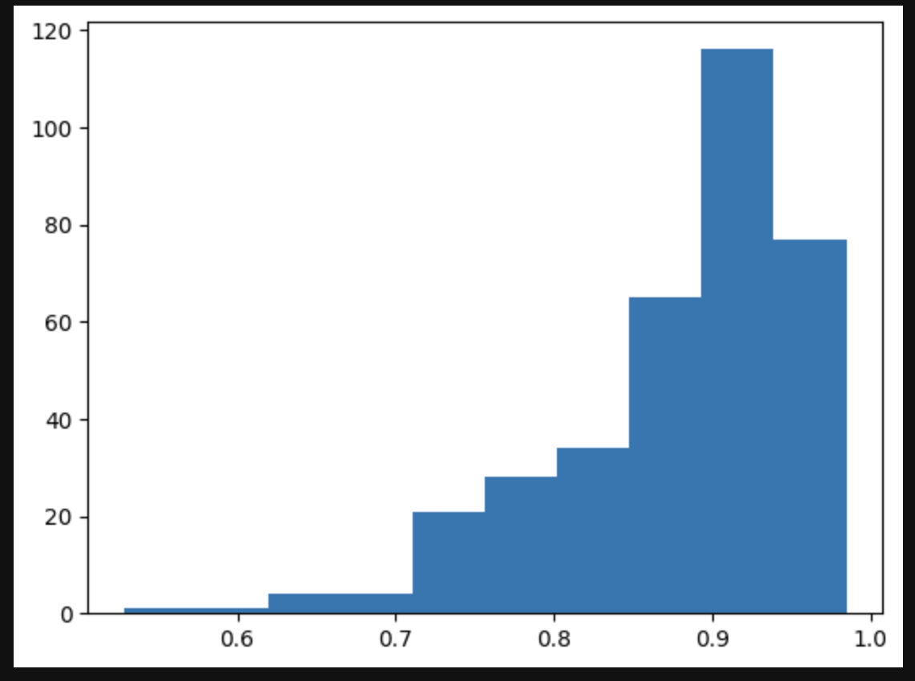
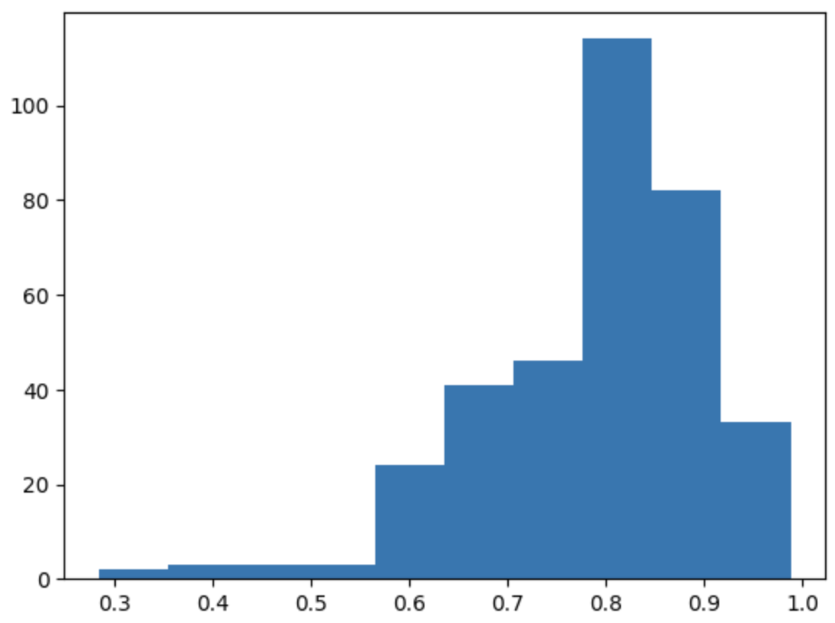
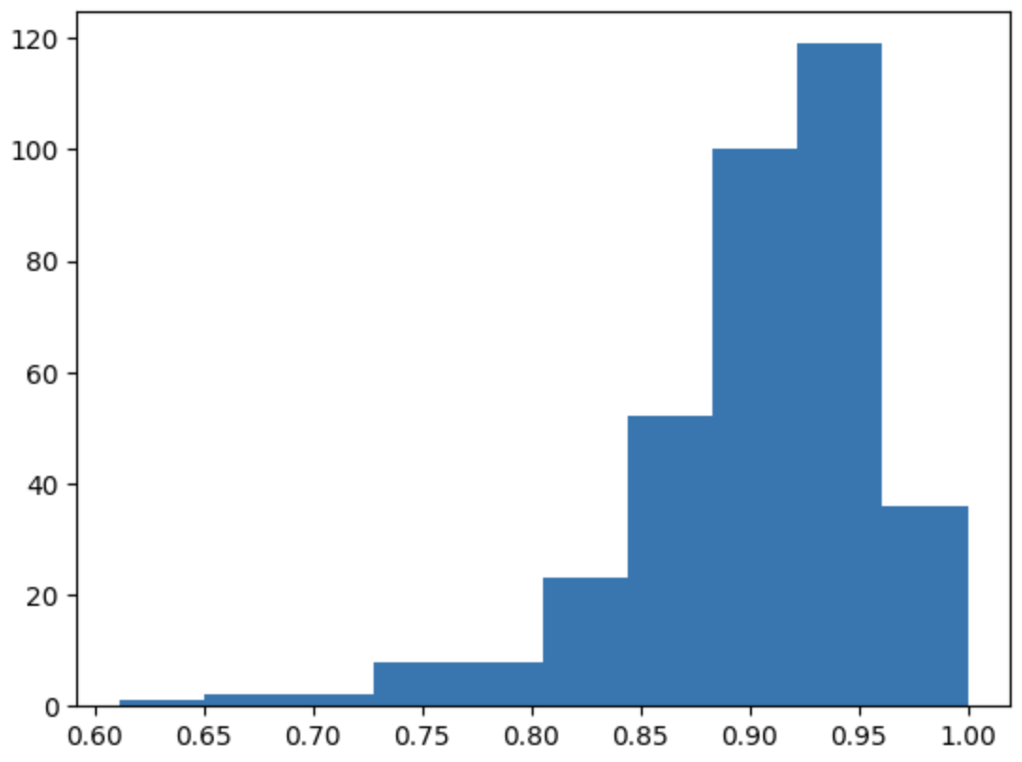
colorfulscoop/sbert-base-ja @ k:4
pkshatech/simcse-ja-bert-base-clcmlp @ k:4
oshizo/sbert-jsnli-luke-japanese-base-lite @ k:4

Slide 17
P1
P2
Most Relevant Paragraph [Pr]
P…
Pn
Regex
Matched ?
True
Start [S] and End[E] indices of P in W
Wiki Article (W)
JaQuAD Context [C]
Regex
Actual unmatched strings, lavenstein_edit_distance

Slide 18
S1
S2
JaQuAD Query [Q]
S…
Sn
Wiki Article (W)
Sentence Transformers based Retrieval
Top K relevant sentences [RC]
JaQuAD Context [C]
Semantically similar ?
True
Score > average
False
Score < average

